Slide 1


AI-Based Predictive maintenance for space missions
Courtney Bernard
ITAI 2372

Slide 2

The Problem
Complex systems
High Risk
Reactive Maintenance
Missed warning signs

Slide 3
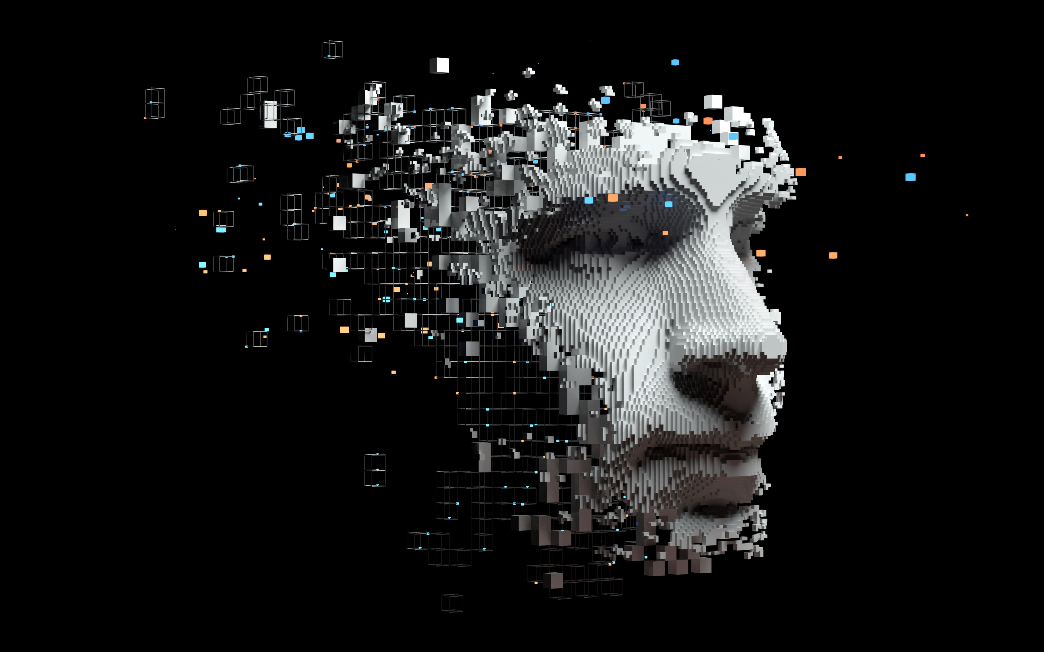
Why it matters
Limited repairs
Astronaut safety
Mission cost
Early detection

Slide 4
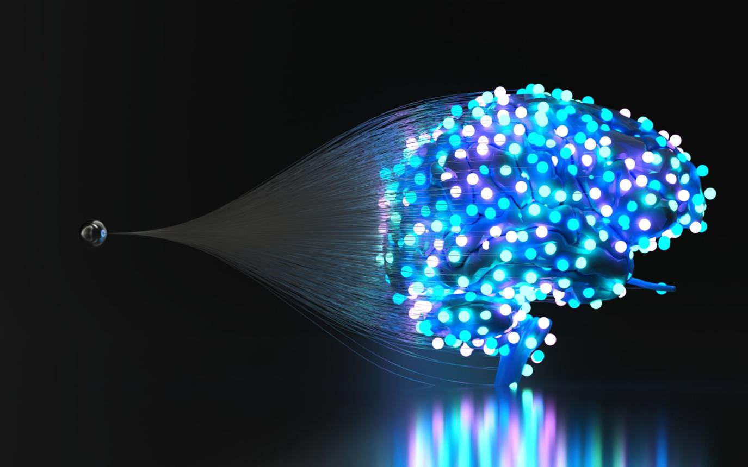
The AI SOLUTION
Machine learning
Data analysis
Pattern detection
Early Warnings

Slide 5

HOW IT WORKS
Collect data
Process data
Train model
Monitor systems
Detect Issues

Slide 6

Benefits
Safety
Early detection
Efficiency
Cost reduction

Slide 7

Challenges
Data quality
False alerts
New failures
Human oversite

Slide 8

Testing
Simulation
Accuracy
Stress testing
Real-time testing

Slide 9

Conclusion
Predict -> Prevent
Safer missions
Smarter Maintenance

